Slide 1
Agenda
Announcements (5 min)
UofSC Update (10 min)
Fraunhofer Update (5 min)
BMW Update / Next Steps(10 min)

Slide 2
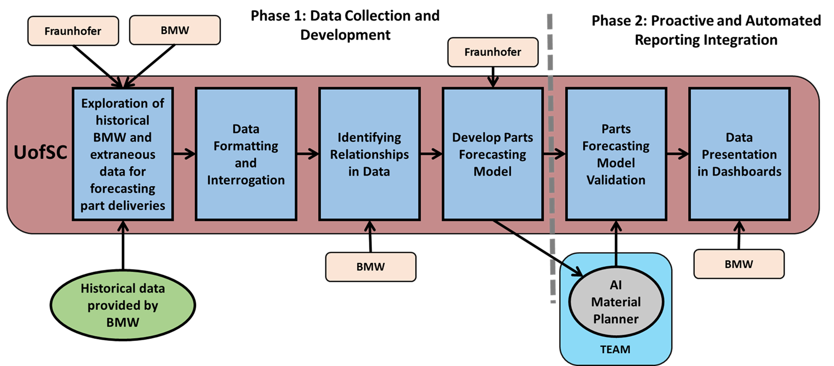
UofSC Team - Status Update for 09/13/2021
UofSC Roadmap
Current Task: Data Exploration
Understand headers (completed)
Get information on quality, ordering times, transportation, etc. (in progress)
Identify poor areas/gaps in data (in progress)
Make timeline of orders (in progress)
Define states (early, tardy, too late) (in progress)
Calculate numbers for tangible and intangible criteria (in progress)
Create supplier ranking (in progress)
Integrate findings into deliverable document
Deliverable: key figures from historical data, rich/poor areas, supplier ranking (Due end of September)
Progress Made Last Week
Plans for this week
Continuing to review the Zgrve and 130 reports and working to understand the header definitions
Understanding relationships between datasets
Revised relationship diagram
Starting analysis for supplier/part ranking
Preliminary database design
Drafting of data dictionary
Finalizing interview questions
Continuing to review the Zgrve and 130 reports and documentation
Continue refinement of data dictionary and database
Prepare for Interviews
Continue working with the Fraunhofer team on database
Work on first deliverable

Slide 3

0 %
100 %
Material Planner (Table 1)
Supplier (Table 2)
Health
Status
Recommendations (Table 6)
Material
Planner
has
1..*
Supplier
(Vendor)
recommend
Responsible
supply
use
Output
1..*
Material
Planning
has
Material
(Part)
input
Material Inventory
input
Material Trans. (Table 4)
use
Material Config. (Table 3)
generate
Exception
Exception (Table 5)

Slide 4

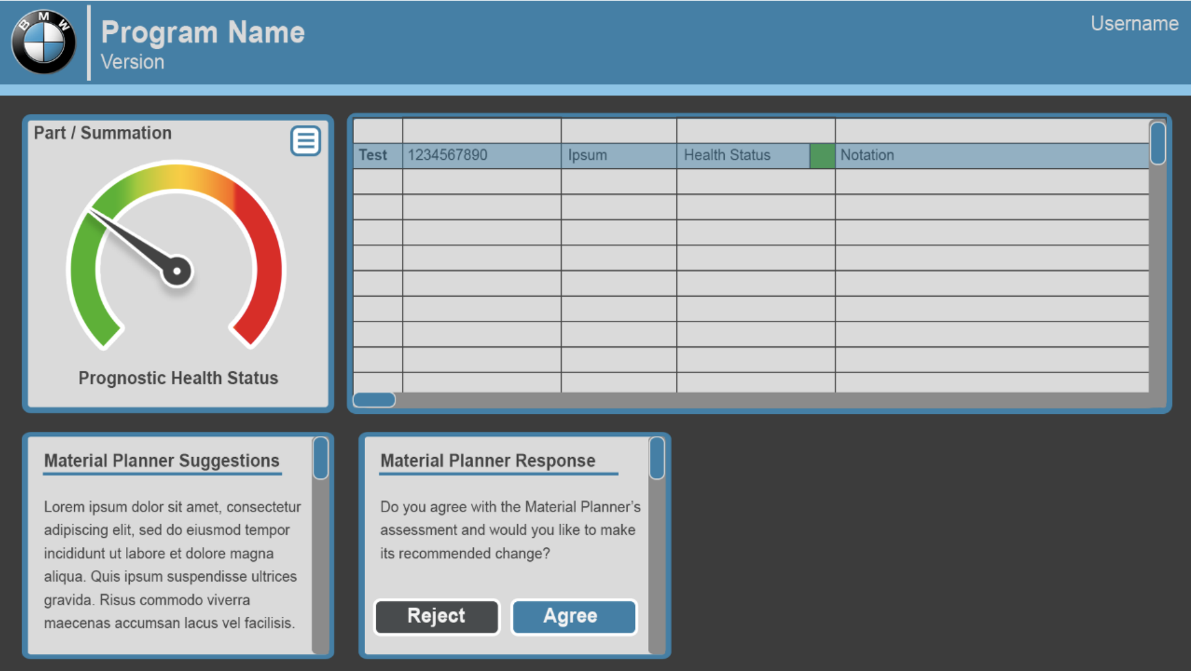





Conceptual design
Parts DB
Fetch and Retrieve Part Info
Dashboard
A
B
H
Get Recommendation
Fetch Part Info
Material Planner (Table 1)
E
Make Recommendation
C
D
G
Supplier (Table 2)
Material Config. (Table 3)
Run Forecast Model
Fetch Forecast Model
Parts
Forecast
Model
I
J
F
Fetch Rulesets
Recommendation
Decision & Reason
Material Trans. (Table 4)
AI Material Planner Assistant
Recommendations (Table 6)
Exception (Table 5)
Rule sets and Business logic

Slide 5
Data Dictionary for Material Planner
Objectives
Identify most important columns for Material Planner
Identify columns that can be imported from Parts DB
Identify columns that can be generated by Reco. Engine and Forecast Model
Data Dictionary Schema
Example
Column | Possible Value
Name
Type | Text/Number/Date
Description
Source | Material Planner (or Part DB)/Algorithm
Frequency of change | High/Low/None
Purpose | Forecast Model, Reco. Dashboard, What..if
Column | Possible Value
SafetyStck
Type | Number
Description | …
Source | Material Planner (or Part DB)
Frequency of change | Low
Purpose | Forecast Model, Reco. Dashboard, What..if

Slide 6
Material Planner (Table 1)
MRPCn (PK)
Vendor ID
Supplier (Table 2)
Vendor ID (PK)
Vendor Name
Material ID
Recommendation (Table 6)
Material ID
Health Status
Material Config (Table 3)
Material ID (PK)
Material Desc
Safety Stock
Planning Time Fence
Safety Time
Planning Calendar
Material Transaction (Table 4)
Material ID
Material Trans. Date
Stock DoS
First Receipt DoS
Exception ID
MRP Element
Available Qty
Exception (Table 5)
Exception ID (PK)
Exception Message

Slide 7
Detail
Data Dictionary

Slide 8
# | Action | Description
A | Fetch Part Info | Planning Assistant queries Parts Data Source for all part information.
B | Retrieve Part info | Planning Assistant Stores part information as a local data set.
C | Run Forecast Model | Planning Assistant feeds Part information to the forecast model.
D | Fetch Forecast Model | Recommendation engine retrieves current Forecast model variables.
E | Fetch Part Info | Recommendation engine retrieves part information.
F | Fetch Rulesets | Retrieve Rules and business logic from Rulesets DB
G | Make Recommendation | Recommendation engine generates recommendation.
H | Get Recommendation | Recommendation, Decision, and Reason is returned from Assistant.
I, J | Update Reco. DB | The database will be updated with the predictions from Forecast Model and recommendations from recommendation engine

Slide 9
MPA Weekly Update 09/13 - Fraunhofer
Summary of last week:
Evaluating potential expert-system framework solutions for the recommendation engine
Continued specifying the rule-sets describing reasons for exemptions and associated material planning actions
Plans for this week:
Continue documenting the concepts/rules based on last week’s discussion.
Proceed with the ER mapping process.
Prepare/plan interviews.
Concerns/Comments:
None

Slide 10
Next Steps
1. SAP and Impacts
Can we get access to the database design or ER-diagrams underlying those systems, particularly in the area of Material Planning.
2. Interviews

